Slide 1
Advanced Programming Practices
Risk Game (Build-1)
Team : Group_U_J
SOEN 6441 Fall-2019
Mehul Prajapati (40076930)
Komal Panchal (40130791)
Maryam Giahi (40016260)
Mahmoudreza Entezami (40058782)
Parth Patel (40081116)
Shubham Ranadive (40083991)

Slide 2
Introduction:
Development of an operational version demonstrating a subset of the capacity of Risk game. It was an effort to implement several extreme programming key features such as Collective ownership, Coding Standards, JavaDoc, Unit Testing and many more.

Slide 3
Functional Requirements:
MAP EDITOR:
Create a new map file
Edit an existing map file
Add/Update/Delete Continent, Country and Adjacent Country
Make sure that the integrity of the connected graph is maintained
GAME PLAY:
Assigning country to player
Player can assign armies to each country in round robin manner
With proper calculation of armies, Reinforcement phase is implemented
With a valid fortification move, Fortification phase is implemented

Slide 4
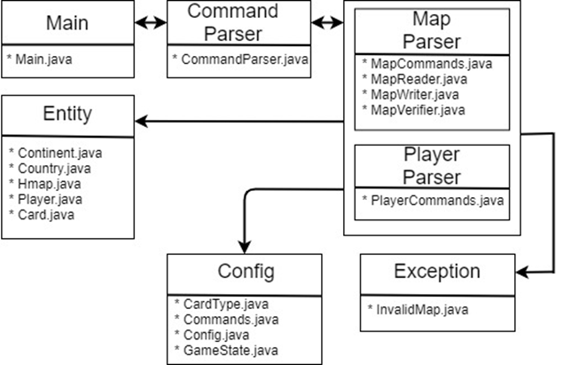
Software Architecture:

